Slide 1
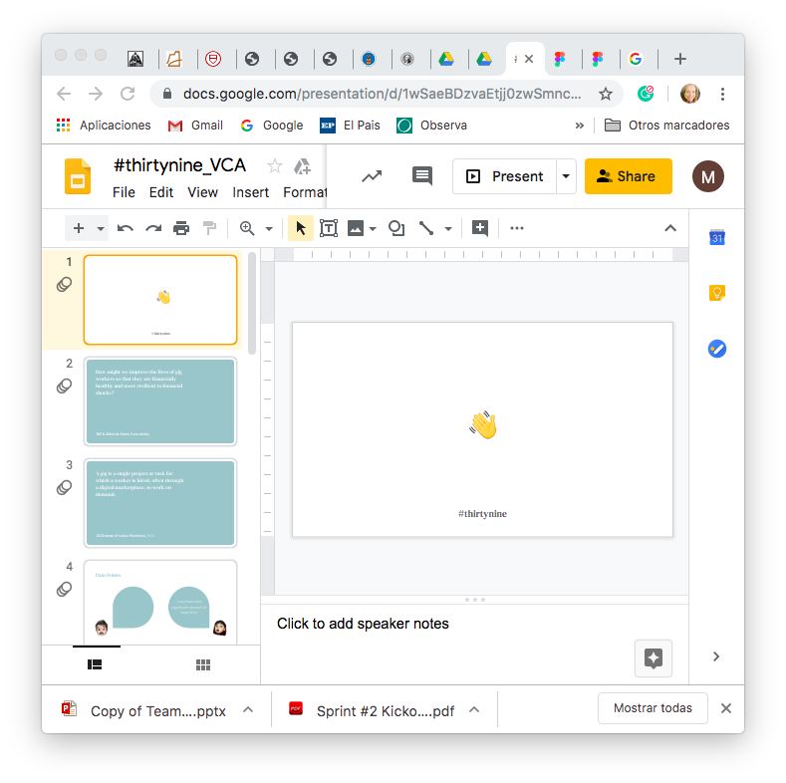
Team #39
Notes:
Welcome to the gig economy! We are full force into this new era of the global workforce and as it expands we need to be adjusting to better meet the demands of its providers and users.

Slide 2
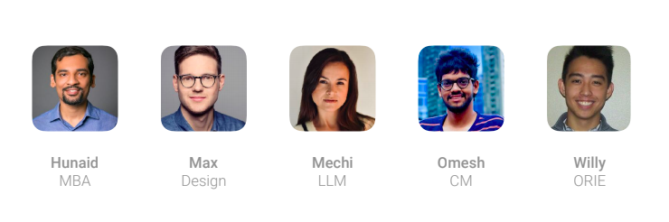
Team #39
Notes:
Welcome to the gig economy! We are full force into this new era of the global workforce and as it expands we need to be adjusting to better meet the demands of its providers and users.

Slide 3
How might we improve the lives of gig workers so that they are financially healthy and more resilient to financial shocks?
Bill & Melinda Gates Foundation

Slide 4
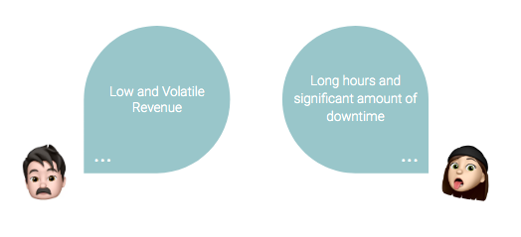

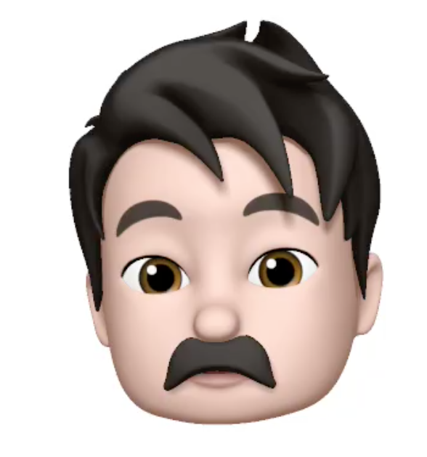
Pain Points

Slide 5
User driven Dashboard App for Gig Workers
We are providing a dynamic and transparent mobile platform that enables gig workers to monitor their markets, make smarter decisions and work more efficiently.

Slide 6

Gustavo Herrera, 46
Notes:
This is Gustavo, a 46 year old New Yorker who drives for Uber and Lyft.
I’d like us to all put on our empathy caps for a minute and think about Gustavo. Gustavo is a 46 year old New Yorker who drives for Uber and Lyft. He has to support his entire family by working for these gig economy platforms.
Well, the question that we are asking is..

Slide 7
Gustavo Herrera, 46
Notes:
This is Gustavo, a 46 year old New Yorker who drives for Uber and Lyft.
I’d like us to all put on our empathy caps for a minute and think about Gustavo. Gustavo is a 46 year old New Yorker who drives for Uber and Lyft. He has to support his entire family by working for these gig economy platforms.
Well, the question that we are asking is..

Slide 8

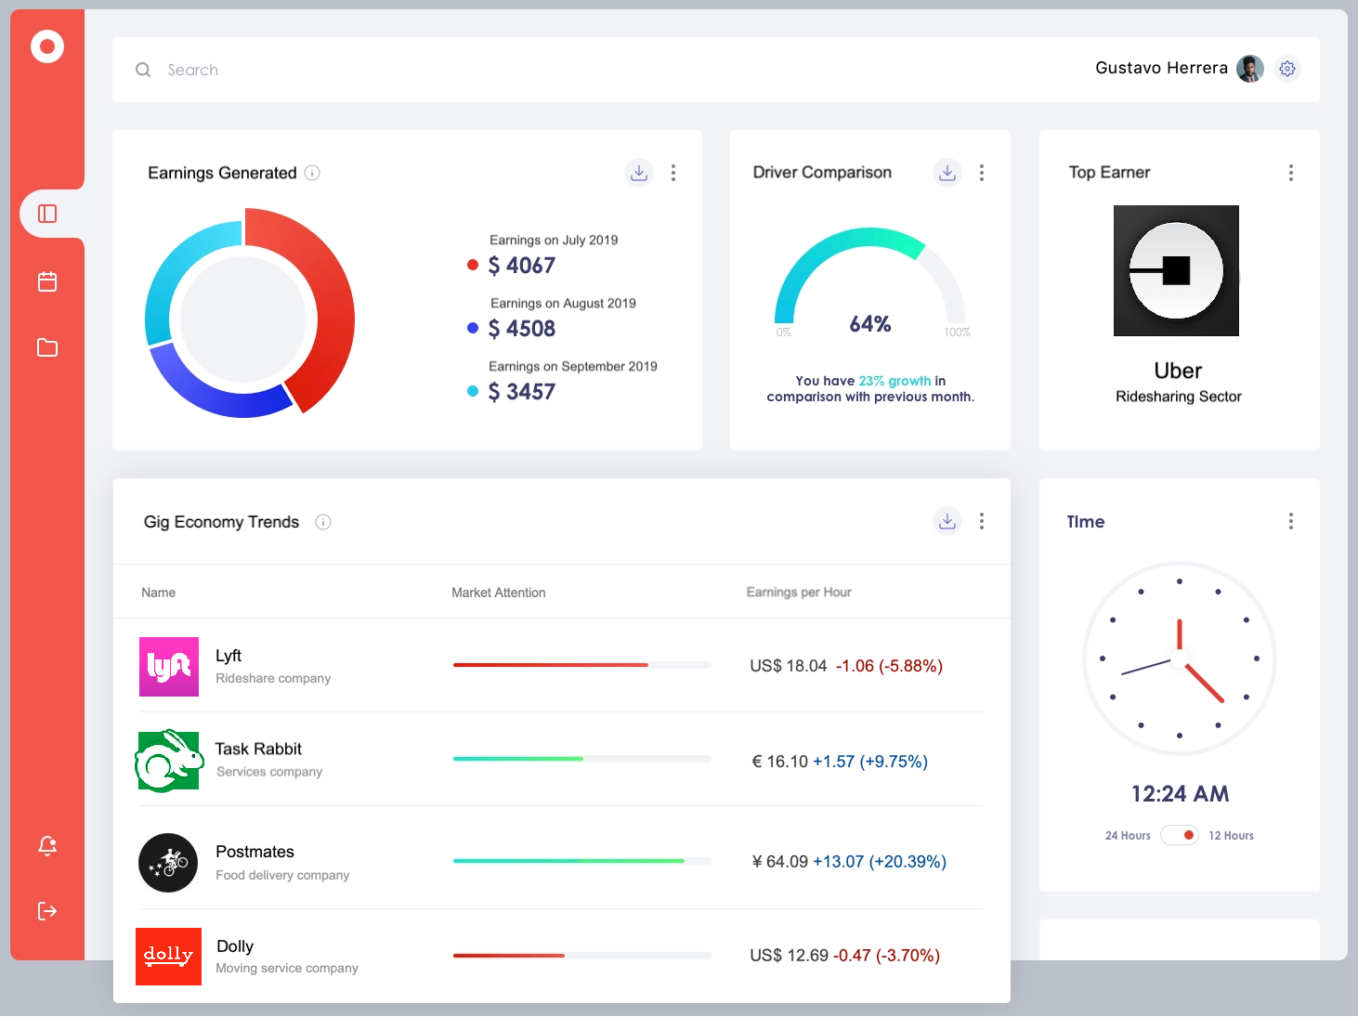
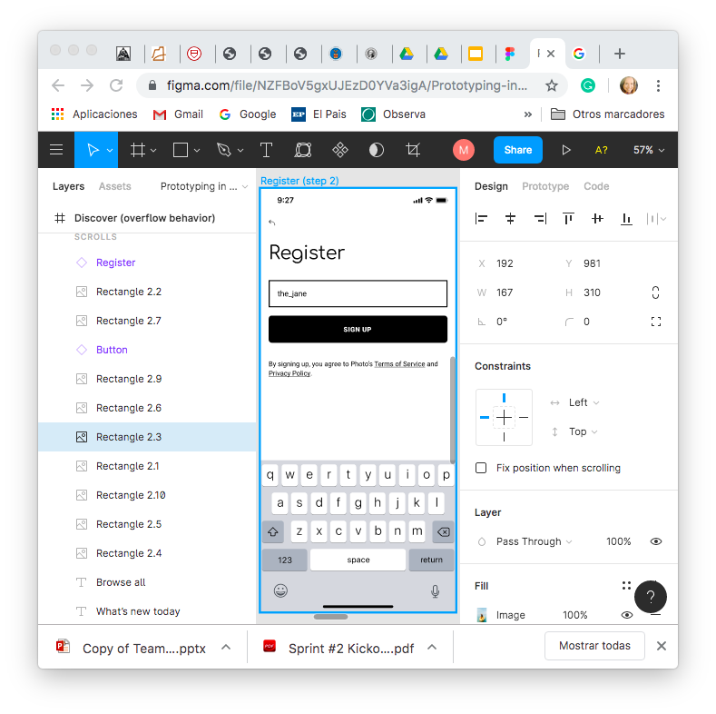
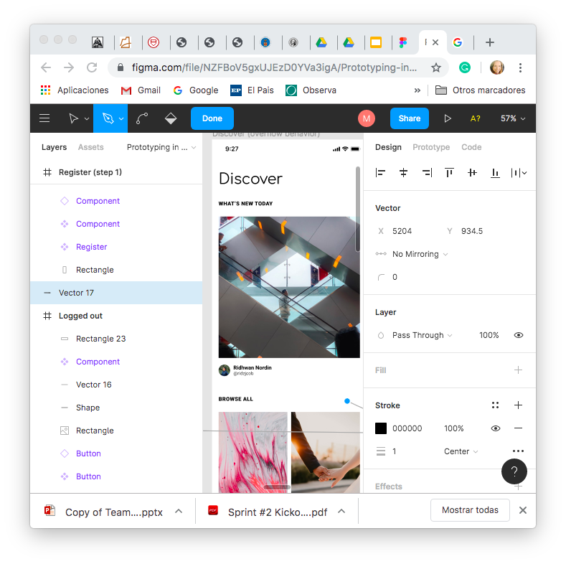
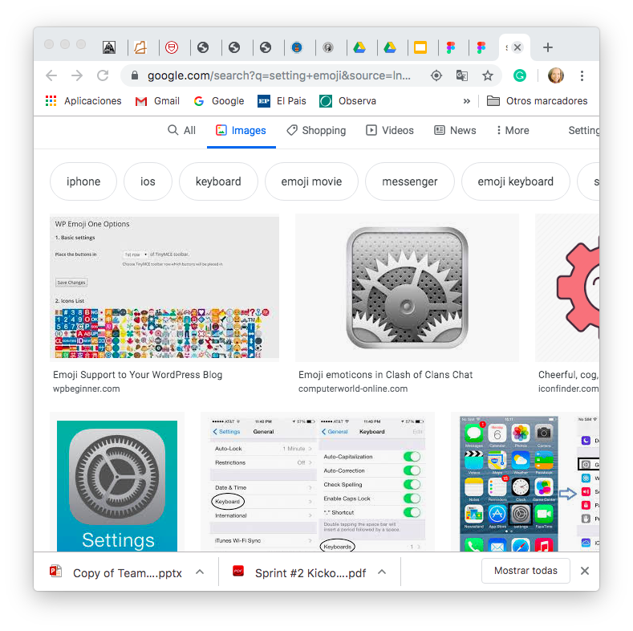
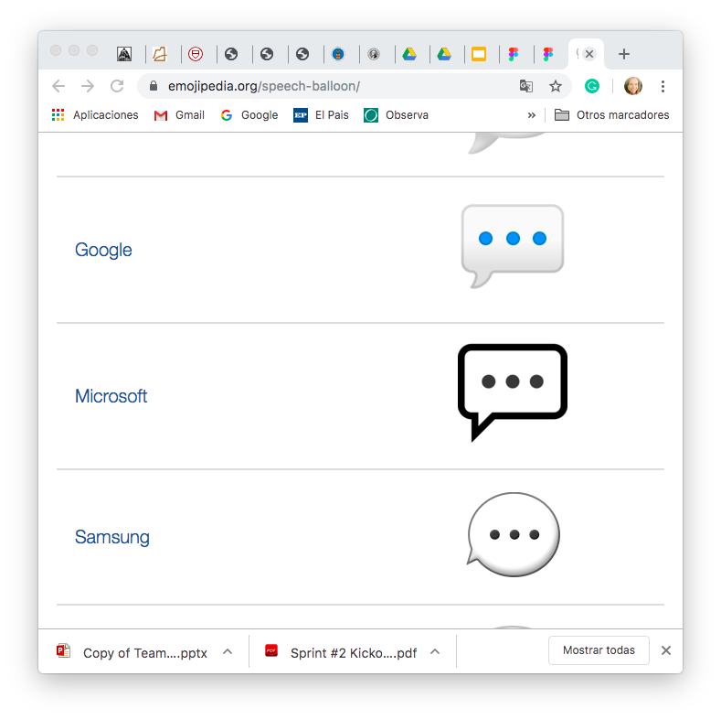
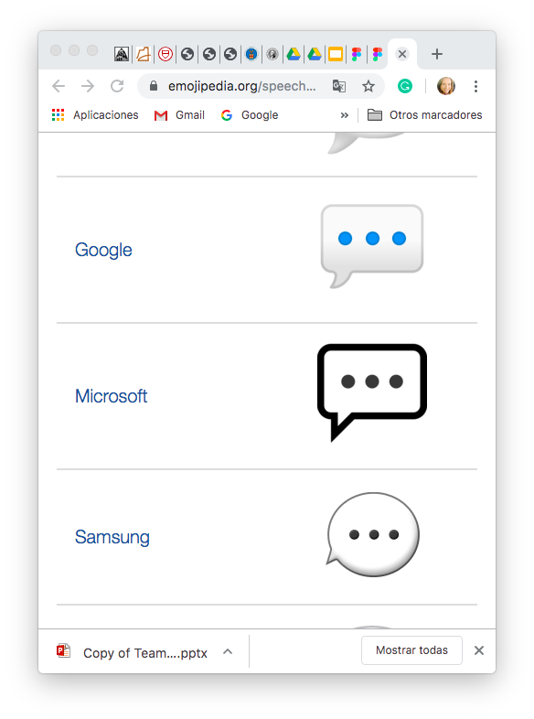
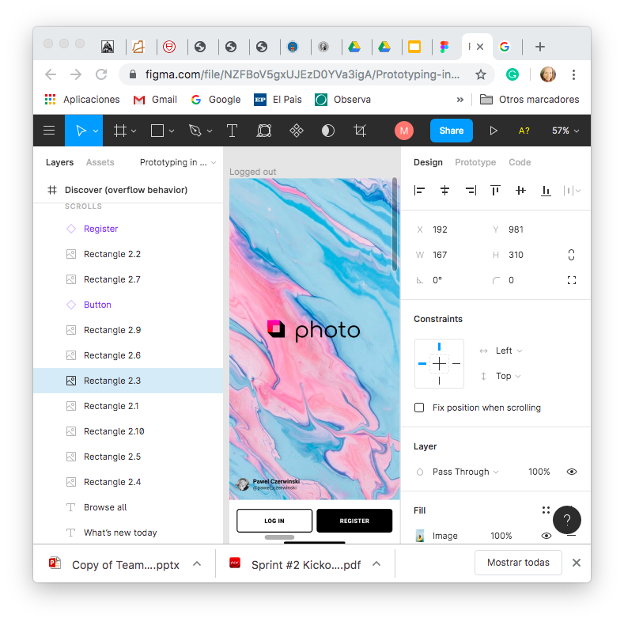
Monitor
Learn + Identity
Improve
Settings

Slide 9




Risks
Will it be used?
Enough / Valuable
information?
Real – Time Prices?
Will GW continue to use?

Slide 10
Risks
Will it be used?
Surveys
Guerrilla Marketing
Reddit
Experiment?
Digital Prototype
Paper Prototype

Slide 11
Risks
Enough / Valuable information?
Technical Features
Data Quality
Experiment?
Access to my emails?
Scrape emails

Slide 12
Risks
Real – Time Prices?
Initial Range
Post - Processing
Experiment?
-generate dummy data
-dynamically show
- generate prototype

Slide 13
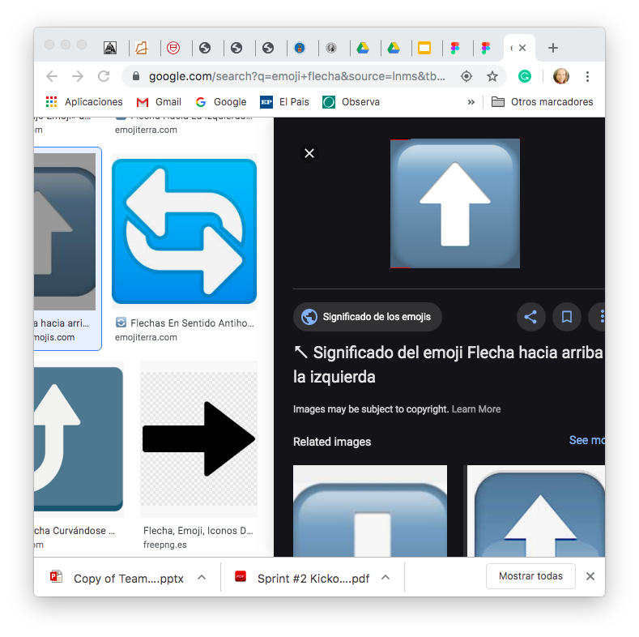
Risks
Will GW continue to use?
User Acquisition cost
Costs
Education
Experiment?
Develop live questionnaire promoting outcomes and responses

Slide 14

Experimentation
Ride-along → give feedback by checking
Text driver → with recommendation
Digital Prototype (e.g.: online forum)
Paper Prototype (e.g.: Uber meetup)
Email scrape (e.g.: pilot setting a log in to prove)
Real time data (e.g.: generate dumming data / generate prototype)
Continue to use (e.g.: live questionnaire)
Data Aggregator

Slide 15
Timeline
1
2
3
4
5
Digital Prototype (e.g.: online forum) – 1 wk.
Paper Prototype (e.g.: Uber meetup) – 1.5 wk.
Email scrape (e.g.: pilot setting a log in to prove) – 3 wk.
Real time data (e.g.: generate dumming data / generate prototype) – 1 wk.
Continue to use (e.g.: live questionnaire) – 3 wk.
Data Aggregator

Slide 16
Thank you!
Data Aggregator

Slide 17
Appendix

